Slide 1
HR Data Competency Program
Overview

Slide 2
The HR Data Competency Program will focus on delivering the Right Data to the Right People at the Right Time
Right Data
Standardized and Reusable Definitions and Metrics
Right People
Secured, Governed and Consistent Access to HR Data
Right Time
Easy, Consistent and Timely Reporting

Slide 3
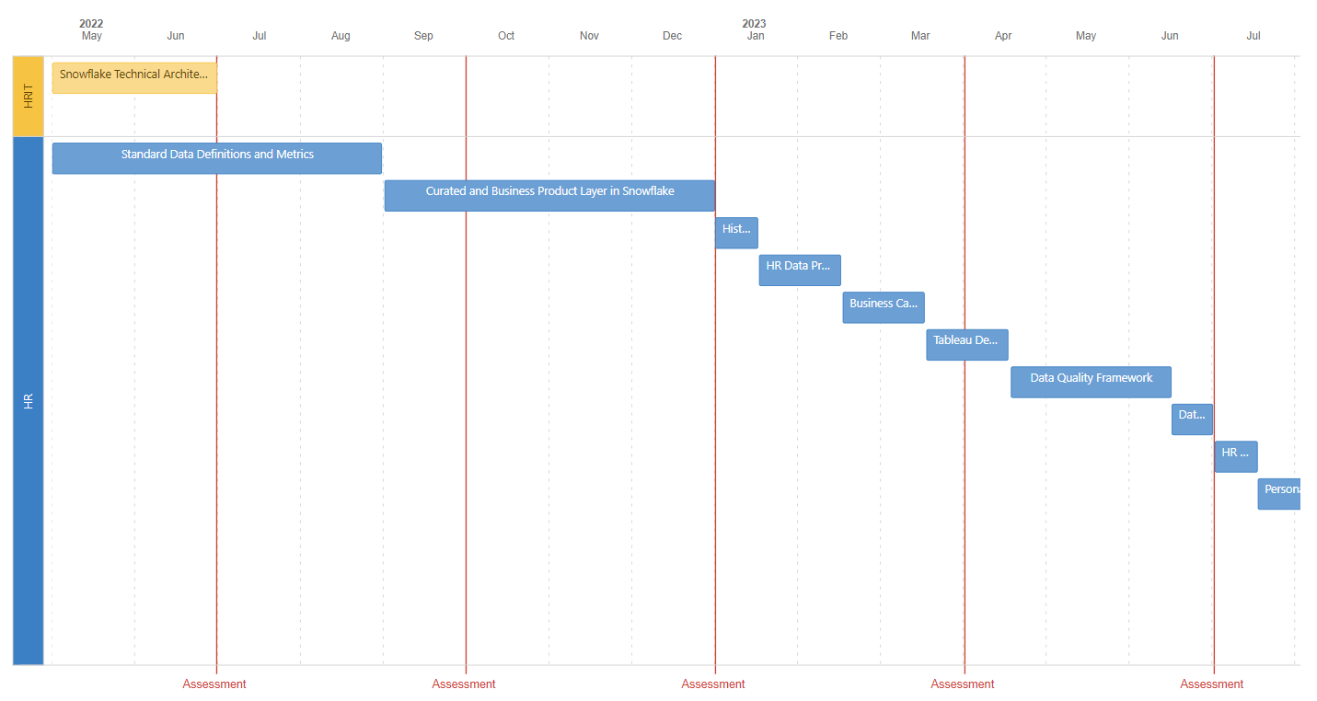
HR Data Competency Program Timeline Overview
Competency Program broken down into 15 Initiatives Spanning 3 Years worth of work
For FY22, we are focusing on the following
1
Snowflake Technical Architectural Updates
2
Standard Definitions and Metrics
3
Data Mart Business Layer Design and Build
Details on the initiatives and program can be found at https://chewyinc.atlassian.net/l/c/RPn1Mf15

Slide 4
FY22 Focus - Details
Begin Key Metrics and Standard Definitions
Derive Standard Definitions and Build Key Metrics
Design and Build Business Layers in HR Data Mart
Begin Snowflake Tech Updates
Alignment on Key Metrics Prioritization
Finish Snowflake Tech Updates
Target Finish of Phase 1 Build of Key Metrics (Begin Phase 2)
Target Delivery of Business Layers of HR Data Mart
Alignment on Key Metrics Prioritization
May 22
June 22
July 22
September 22
November 22
Initiative Key
Snowflake Technical Updates
Standard Definitions and Key Metrics
HR Data Mart Business Layers

Slide 5
Key Metrics and Standard Definitions
Initiative 01

Slide 6
Initiative 1: Key Metrics and Standard Definitions (Approach)
Start with Priority Phase 1 Metrics
Identify and Align on Prioritization of Metrics
Find Existing Definitions Across HR Products and Teams
Convene Stakeholders to Align on Definitions
Build Metrics into Data Mart
Repeat with next set of Metrics
Change HR Products to Use Data Mart
Current Progress
The EPA team has taken an initial pass at identifying the list of key HR metrics. Out of 89 identified metrics, we’ve proposed 34 of the metrics as Phase 1 Priorities for FY22.
Reference
https://chewyinc.atlassian.net/l/c/JoRdcHE4

Slide 7
Strategic Measurement Areas for HR (Metrics)
Green = Proposed Priority for Phase 1
Underlined = Have Definition, Need Confirmation and Alignment
HIRE
PERFORM
ENGAGE
DEVELOP
RETAIN
Recruiting Effectiveness
Performance Management
Engagement
Measurement
% Employee Satisfaction (eSAT) Score
Burnout Rate
Engagement Index
Likeliness to Recommend (NPS)
Learning & Training
Retention
Risk
# of Fills
# of Hires
# Open Requisitions
# Open Requisitions Outside of SLA
% Fills in SLA
% Labor Order Filled
% to HC Plan (FY)
Time to Fill
# 360 Reviews and Distribution
# Goals Set / Completed
Mid-Year Review Distribution
Performance Distribution (9-Box / Top Performers)
Performance Trends
# / Rate Compliance Training Completed
# of Compliance Training Assigned
# of Trainings Assigned
# of Trainings Completed
# of Voluntary Content Completed
Average Learning Logins per Employee
Graduation Rates / #
Top Searches for Content (Learning)
Annualized Attrition
Attrition Forecasted FY
Attrition FY Total
Attrition FYTD
Attrition Involv Term
Attrition Rate
Attrition Regretted / Non Regrettable
Attrition Total Term
Attrition Vol Term
Normalized Attrition
Period Attrition
Quality of Hire
Workforce Productivity
Manager Effectiveness
# of Assesment Pass Rate
# of Hires by Source
Attrition Less than 1 Year
Average Candidate Score (Greenhouse)
Pre-hire Assesment Pass Rate
Employee
Sentiment
At Risk Words (ER Related)
Employee Sentiment (polarity)
Top Themes by Location or BU
# Action Plans Completed
# Manager Check-Ins
Manager Insability Rate
Span of Control (Direct / Indirect)
Top Leadership Competencies
% Scheduled Hours Worked
Average Tenure
PTO/UTO/VTO Rates
Workforce Planning
% (Whatever CS has)
% FCPU
% Labor Forecast Accuracy
% Remote Worker (by type)
% SGA
HC Growth Rate
Headcount (previously BIS)
Career Growth
# of Promotions
# Transfers
Dwell time
Dwell time (level)
Dwell time (role)
Promotion Rate
Transfer Rate
Reward Differentiation
Diversity
& Inclusion
# New Hires by University
# of Job Descriptions De-biased
% Compensation Difference by Gender / Ethnicity
% Interns by Source
Attrition by Gender / Ethnicity
Headcount by Gender / Ethnicity
Women in Leadership
Women in Technology
Average %ile of Compensation Range
Pay for Performance (Average Compensation Increase by Performance)
Time since last comp change
Funnel
Succession Planning
# Applicants / Conversion Rate
# of Starts / Conversion Rate
# Offers Accepted / Conversion Rate
# Offers Extended
# Panel / Conversion Rate
# PS 1&2 / Conversion Rate
# Leadership Positions without Successor Nominations
Average # of Successor Nominations
Average Time in Role (Leadership)
Average Wait Time
Internal vs External Fill Ratio (Leadership)
# Ready for Leadership

Slide 8
How Can You Help?
Help us make sure we’re working on standardizing the metrics that are most important to you and your lines of business
Help us define the metrics, and make yourself and / or your delegates available and prioritize involvement in aligning on definitions across the enterprise
Help Prioritize the Key Metrics
Stakeholder Engagement
As we build out the standard metrics, we’ll need to encourage people to use the standard metrics, instead of building their own from scratch and causing inconsistent results
https://www.surveymonkey.com/r/YS8ZMSC
Results will close end of business on June 24th
We will then consolidate votes, and create the prioritization roadmap for the metrics
Socialize the Standards
Fill Out The Survey

